Slide 1

WELCOME
COHORT 5
7th Sept – 3rd Dec 2026
Suite 6-6-7, Level 6, Menara MAA

Slide 2



Languages for Building Web Application
Build a web page structure
Add stylings to web page
Add dynamic behavior/interactivity
to web page
Notes:
How it works:
When you visit a website, your web browser (like Chrome, Firefox, Safari, Edge) downloads the HTML file for that page. The browser then reads the HTML code and renders it visually on your screen, displaying the text, images, and other elements according to the instructions given by the HTML tags.
It's important to note that HTML is primarily for structure and content. For styling (colors, fonts, layout) you use CSS (Cascading Style Sheets), and for interactivity (animations, dynamic content) you use JavaScript. Together, HTML, CSS, and JavaScript form the core technologies of the World Wide Web.

Slide 3
Introduction to CSS
  CONTENTS:
  What is CSS?
  CSS Syntax
  Ways to Add CSS
  CSS Selectors
  CSS Properties
  Colors and Backgrounds
  Text and Fonts

Slide 4
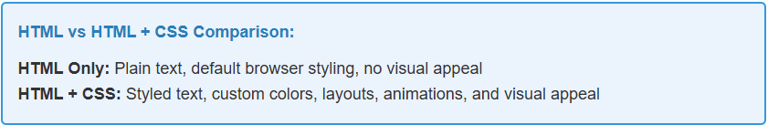
What is CSS?
  CSS stands for Cascading Style Sheets
  CSS is a stylesheet language used to describe the presentation of HTML documents.
  CSS controls how that content looks, while HTML provides structure and content.
  CSS makes website beautiful and functional.

Slide 5
What is CSS?
What CSS Controls:
  Colors and background
  Fonts and text styling
  Layout and positioning
  Spacing and sizing
  Animations and transitions
  Responsive design
Benefits of CSS:
  Separation of Concerns
  Reusability
  Maintainability
  Performance
Notes:
Separation of Concerns - Content (HTML) separate from presentation (CSS)
Reusability - One CSS file can style multiple HTML pages
Maintainability - Easy to update styles across entire website
Performance - CSS files can be cached by browsers

Slide 6
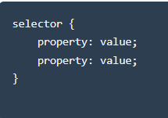
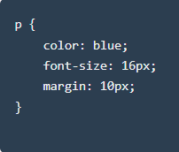
CSS Syntax
Basic CSS Rule Structure:
Example CSS Rules:
  Explanation:
  p = Selector (targets all paragraph elements)
  color: blue; = Property and value (makes text blue)
  ; = Semicolon separates each declaration
  { } = Curly braces contain all declarations (color, font, margin)

Slide 7
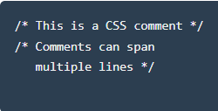
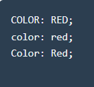
CSS Syntax
CSS Comments:
CSS is Case-Insensitive:
  Explanation:
  CSS comments are used to ensure readability and maintainability of the styles incorporated.
  CSS is case-insensitive (uppercase, lowercase or all-caps would still indicate equivalent syntax)

Slide 8
Ways to Add CSS to HTML file
  1. Inline CSS (Highest Priority):
  CSS written directly in HTML elements using the style attribute
  2. Internal CSS (Medium Priority):
  CSS written in the <style> tag within the HTML document’s <head>
  3. External CSS (Lowest Priority):
  CSS written in separate .css files and linked to HTML

Slide 9
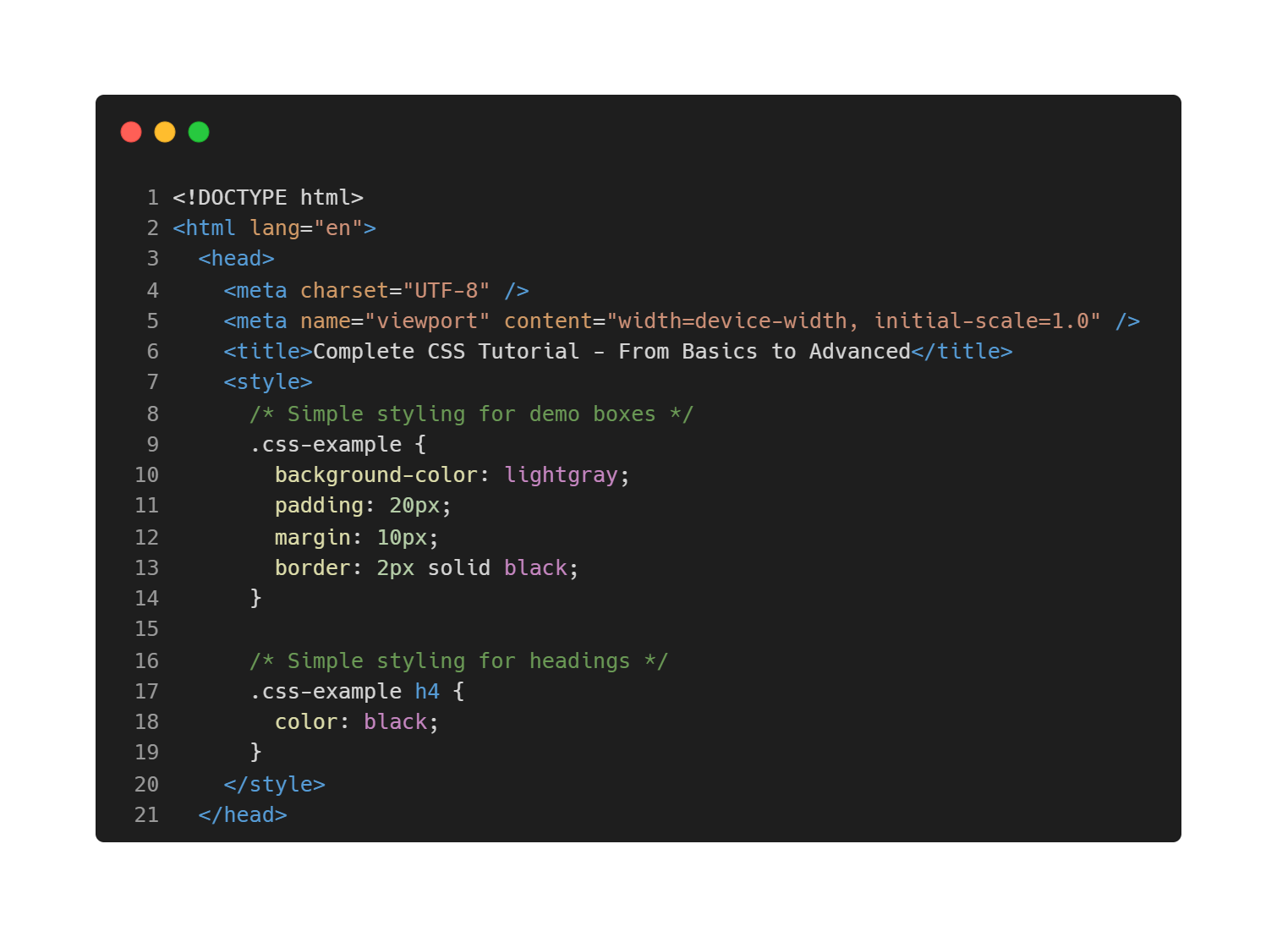
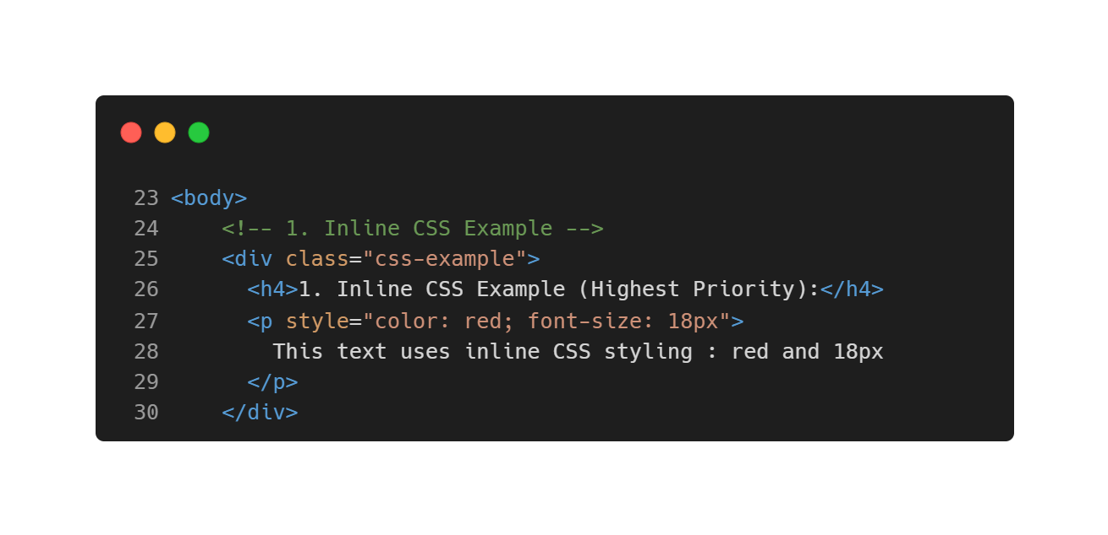
Ways to Add CSS to HTML file
  1. Inline CSS (Hands On):

Slide 10
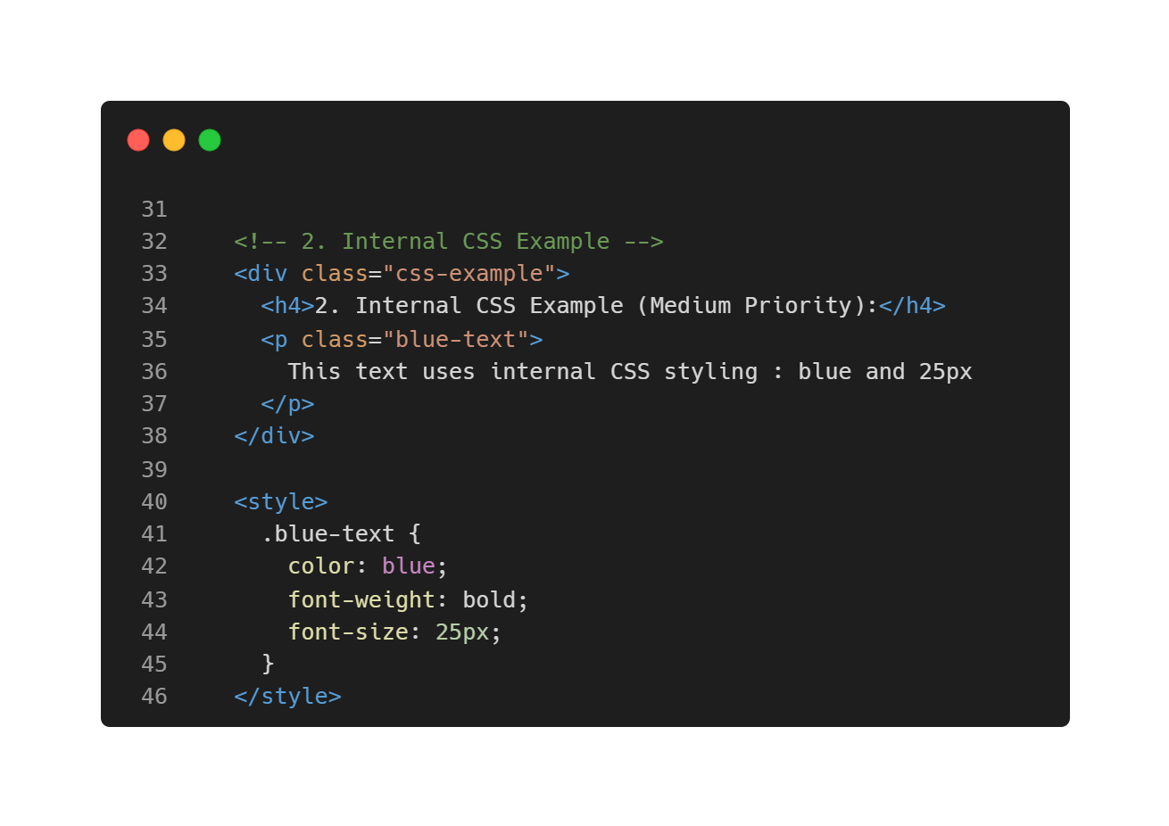
Ways to Add CSS to HTML file
  2. Internal CSS (Hands On):

Slide 11
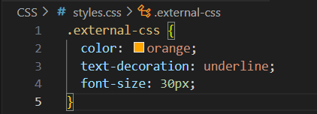
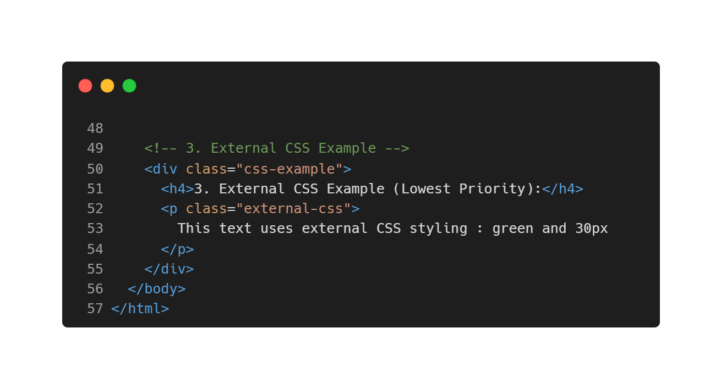
Ways to Add CSS to HTML file
  3. External CSS (Hands On):
  Create a new file in the same folder named styles.css
<link rel="stylesheet" href="styles.css" />
  Add this line between codes # 6 and 7 to import and use .css file
  Complete the codes for external CSS example and ensure the format is as per your styles in .css file

Slide 12
CSS Selectors
  1. Element Selectors:
  Target HTML elements by their tag name
  2. Class Selectors:
  Target elements with specific class attributes using .
  3. ID Selectors:
  Target elements with specific ID attributes using #
  4. Attribute Selectors:
  Target HTML elements by their tag name

Slide 13
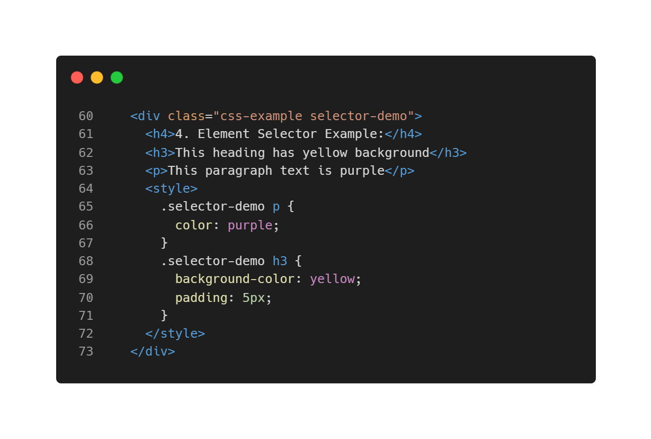
CSS Selectors
  1. Element Selectors (Hands On)

Slide 14
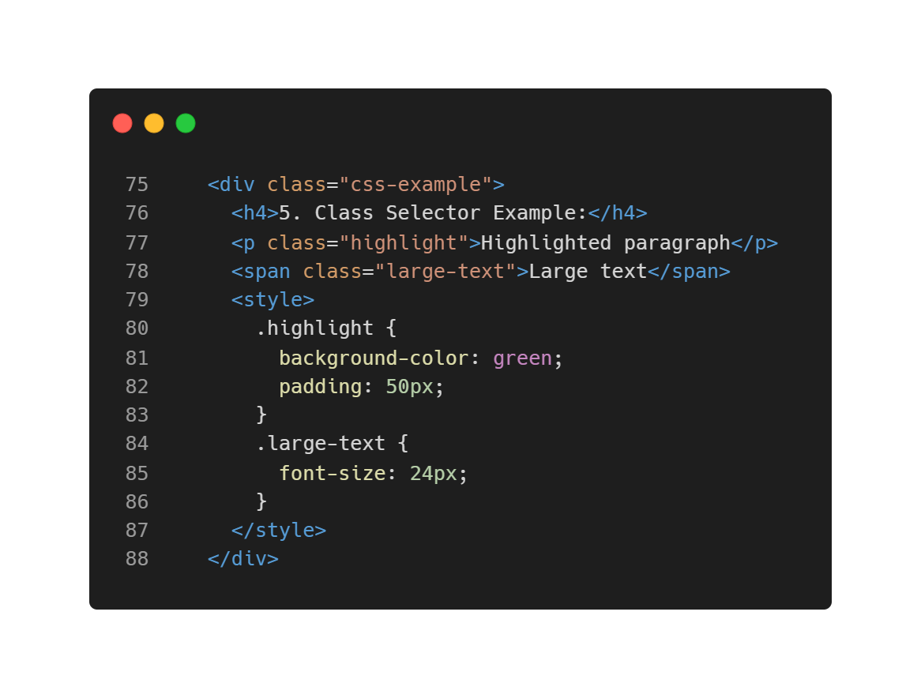
CSS Selectors
  2. Class Selectors (Hands On)

Slide 15
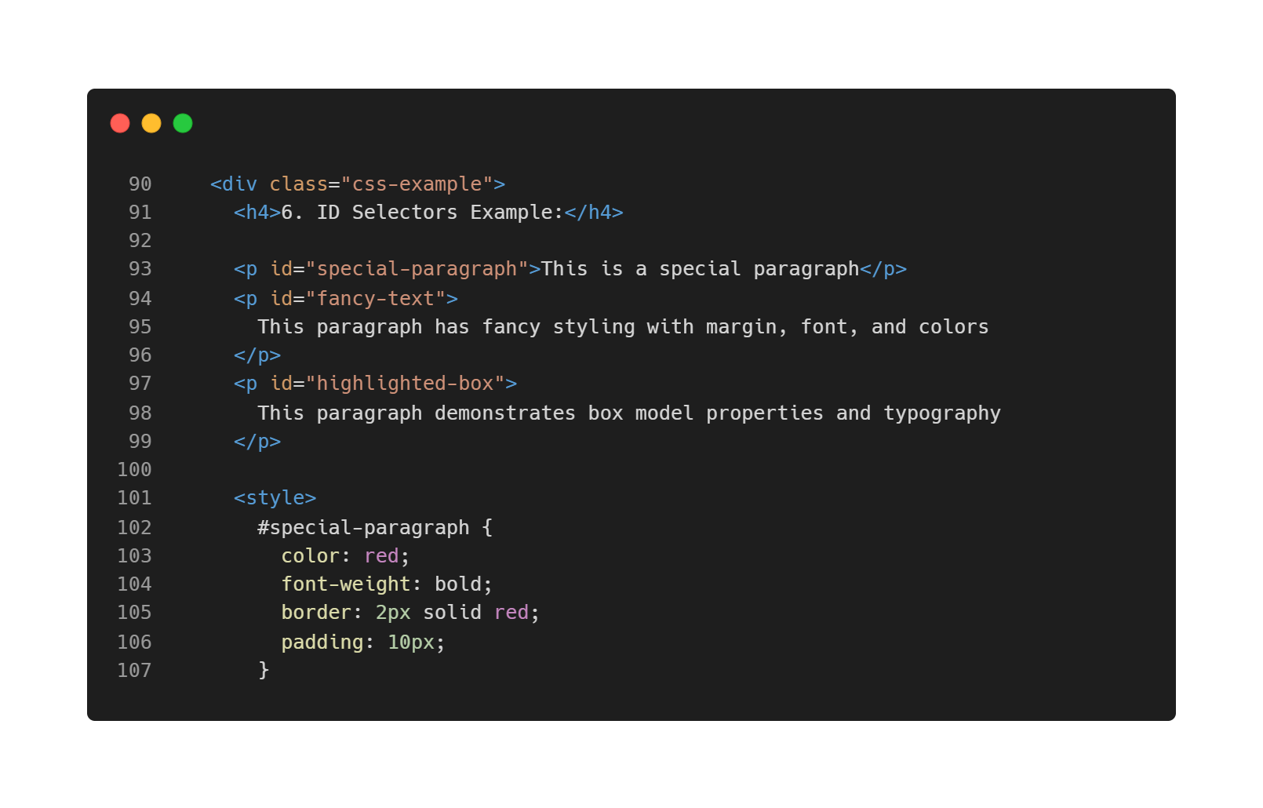
CSS Selectors
  3. ID Selectors (Hands On)
  ID no 1 is #special-paragraph

Slide 16
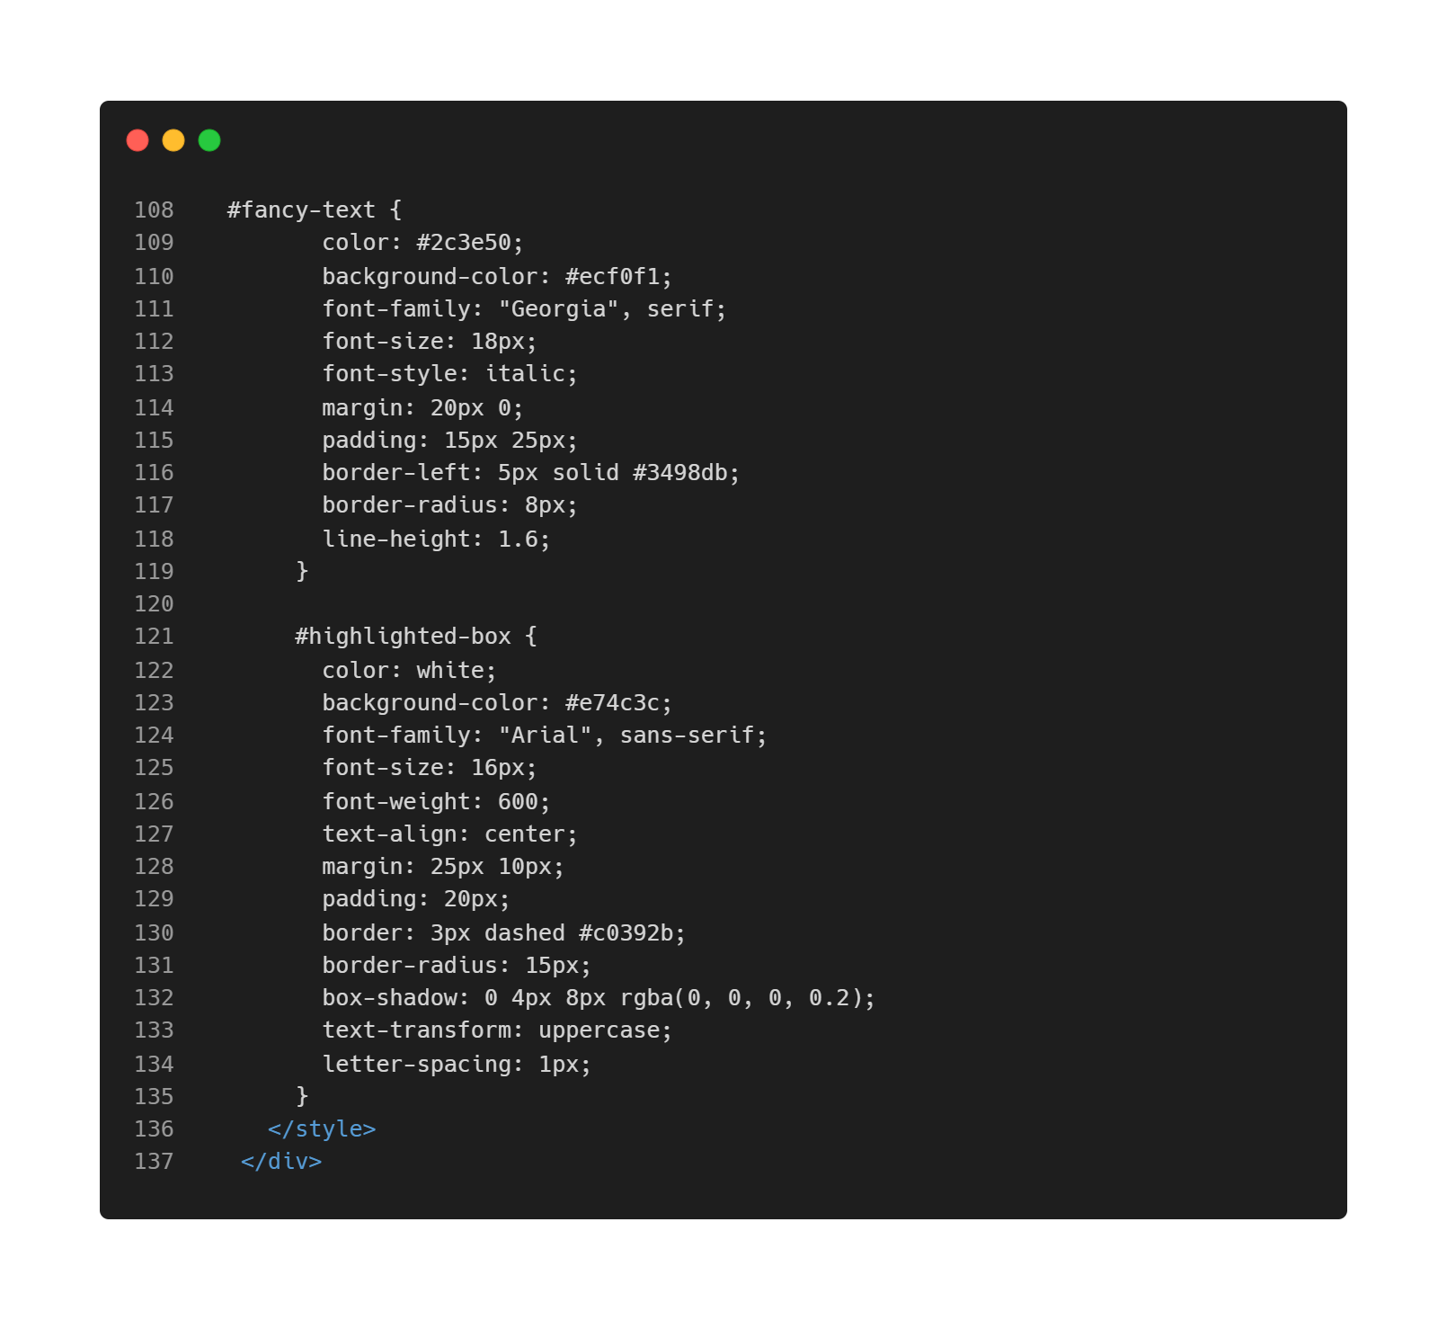
CSS Selectors
  3. ID Selectors (Hands On)
  ID no 2 is #fancy-text
  ID no 3 is #highlighted-box

Slide 17
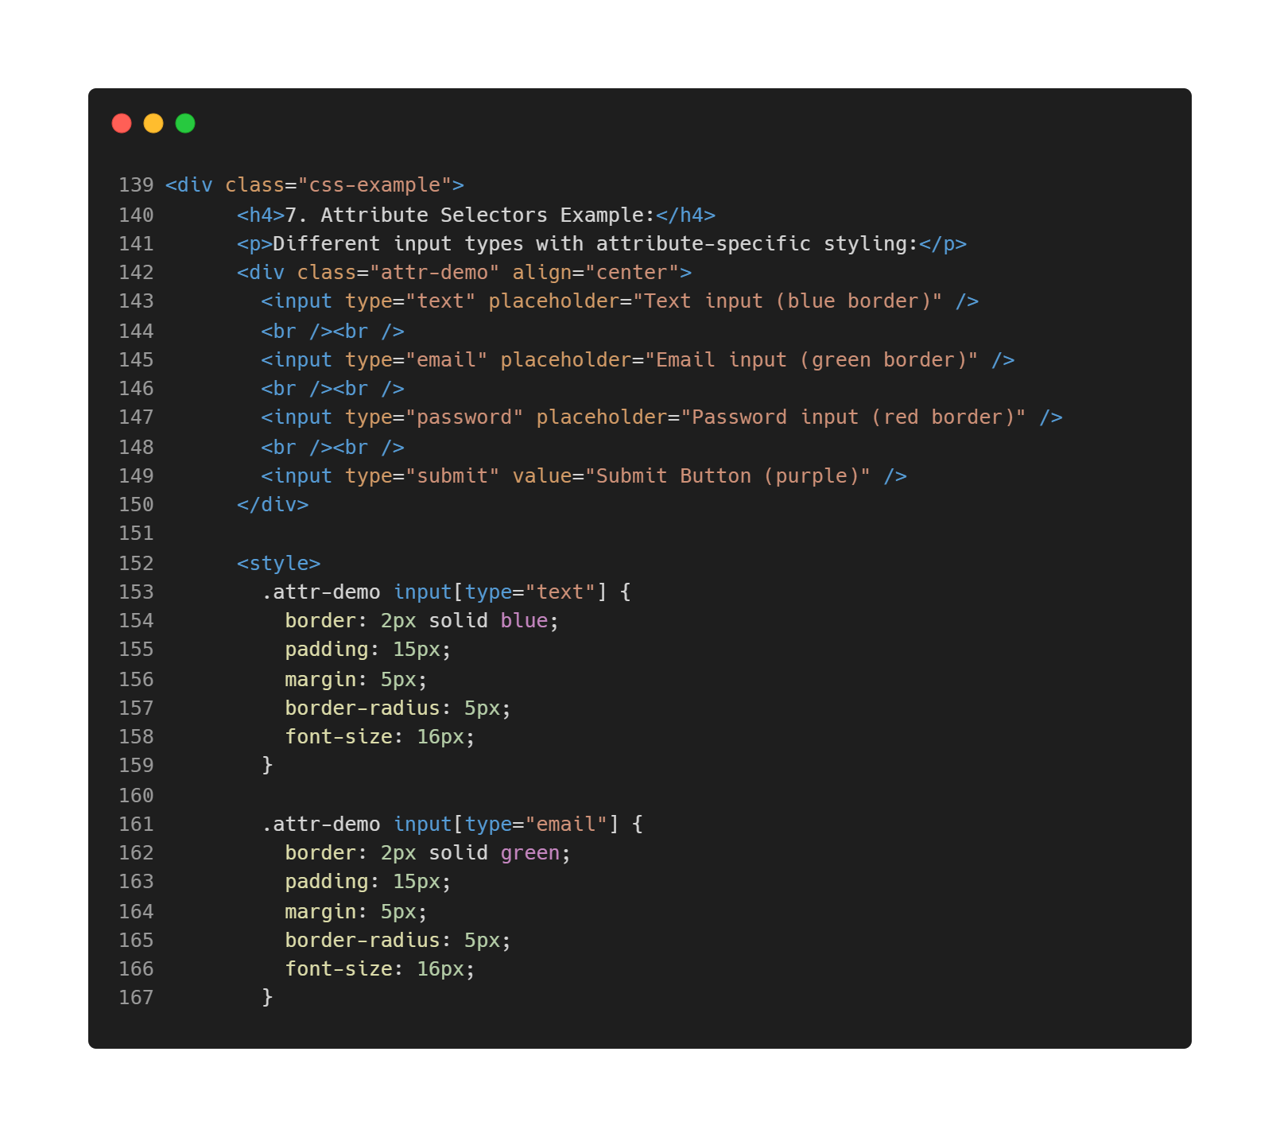
CSS Selectors
  4. Attribute Selectors (Hands On)
  Attribute input type no 1 - Text
  Attribute input type no 2 - Email

Slide 18
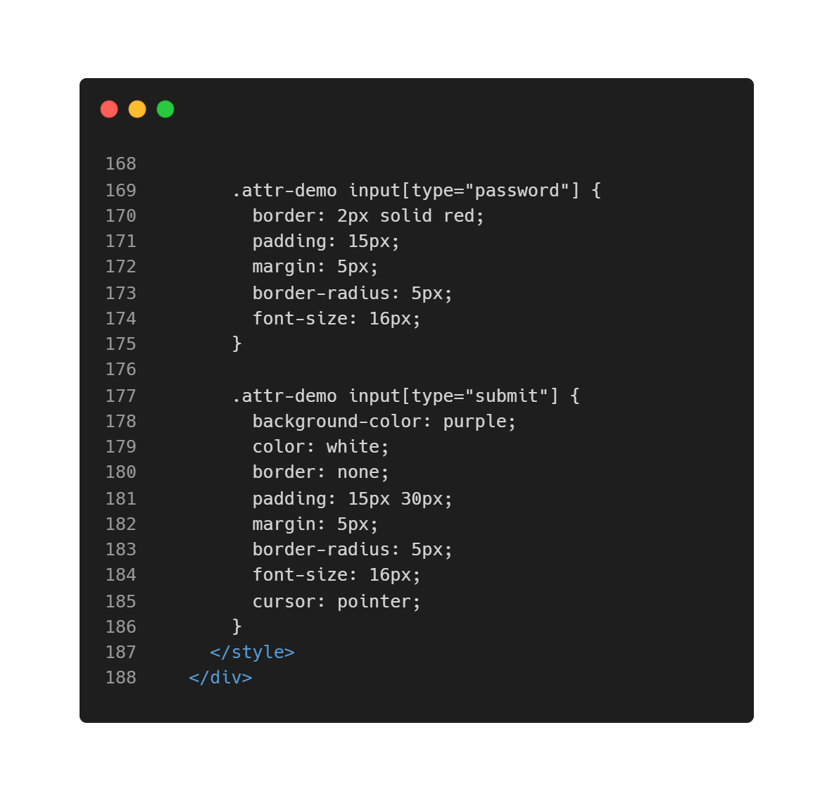
CSS Selectors
  4. Attribute Selectors (Hands On)
  Attribute input type no 3 - Password
  Attribute input type no 4 - Submit

Slide 19
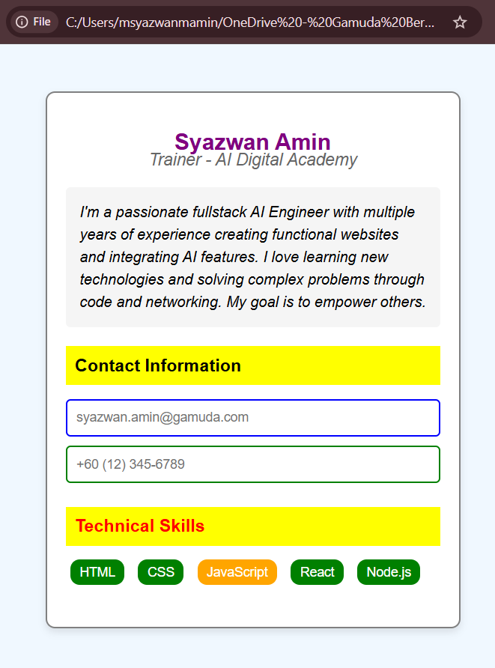
Exercise 1 : Profile Card with CSS
Create the profile card on the right using the suitable CSS syntax
Centered, white card on a light blue background
A purple name heading
Gray italic job title
Bio section with light gray background
Yellow-background section headers
Colored input fields
Interactive skill tags that grow on hover
Professional, clean layout
Notes:
Start with this HTML Outline and style your way using CSS as per above specifications:
<!DOCTYPE html>
<html lang="en">
<head>
<meta charset="UTF-8">
<meta name="viewport" content="width=device-width, initial-scale=1.0">
<title>My Profile Card</title>
<!-- Add your internal CSS here -->
<style>
/* Your CSS code goes here */
</style>
</head>
<body>
<div class="profile-card">
<h2 id="profile-name">Your Full Name</h2>
<p class="job-title">Your Job Title/Student</p>
<p id="bio">Write a short bio about yourself (2-3 sentences)</p>
<div class="contact-info">
<h3>Contact Information</h3>
<input type="email" placeholder="your.email@example.com" readonly>
<input type="tel" placeholder="+1234567890" readonly>
</div>
<div class="skills">
<h3>Skills</h3>
<span class="skill">HTML</span>
<span class="skill">CSS</span>
<span class="skill highlight-skill">JavaScript</span>
</div>
</div>
</body>
</html>

Slide 20
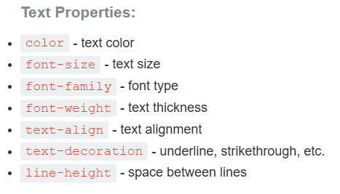
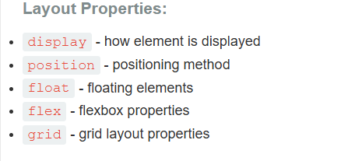
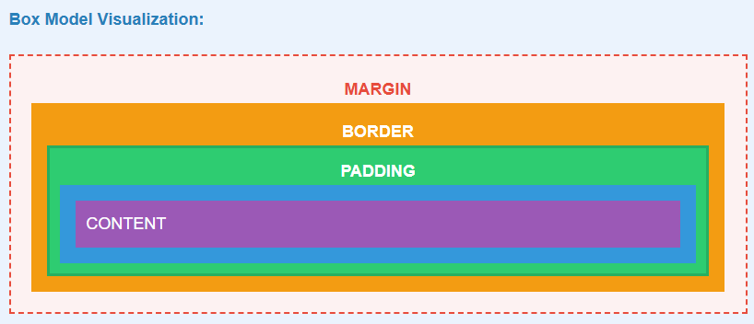
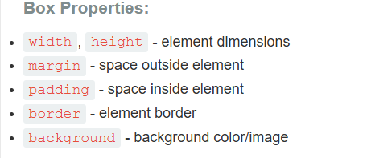
CSS Properties

Slide 21
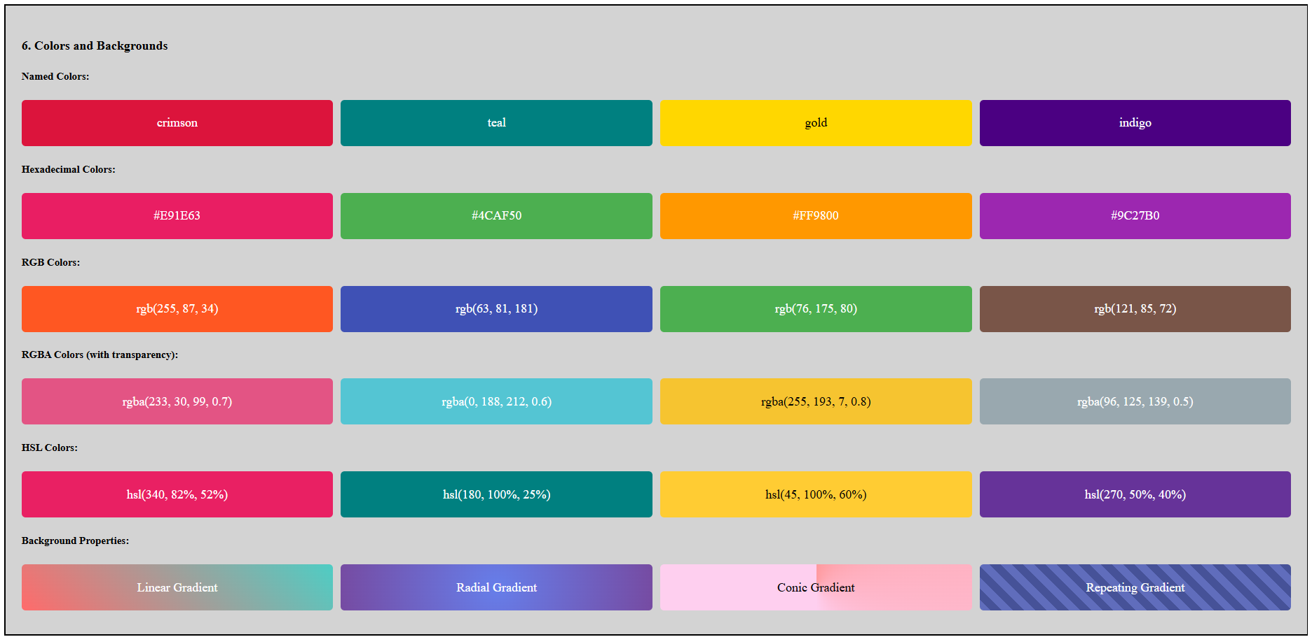
CSS Colors & Background
  Sample Website Reference for Colors - https://www.w3schools.com/css/css_colors.asp
Notes:
<div class="css-example">
<h4>6. Colors and Backgrounds</h4>
<h5>Named Colors:</h5>
<div style="display: flex; gap: 10px; margin: 10px 0">
<div
style="
background-color: crimson;
color: white;
padding: 20px;
border-radius: 5px;
flex: 1;
text-align: center;
"
>
crimson
</div>
<div
style="
background-color: teal;
color: white;
padding: 20px;
border-radius: 5px;
flex: 1;
text-align: center;
"
>
teal
</div>
<div
style="
background-color: gold;
color: black;
padding: 20px;
border-radius: 5px;
flex: 1;
text-align: center;
"
>
gold
</div>
<div
style="
background-color: indigo;
color: white;
padding: 20px;
border-radius: 5px;
flex: 1;
text-align: center;
"
>
indigo
</div>
</div>
<h5>Hexadecimal Colors:</h5>
<div style="display: flex; gap: 10px; margin: 10px 0">
<div
style="
background-color: #e91e63;
color: white;
padding: 20px;
border-radius: 5px;
flex: 1;
text-align: center;
"
>
#E91E63
</div>
<div
style="
background-color: #4caf50;
color: white;
padding: 20px;
border-radius: 5px;
flex: 1;
text-align: center;
"
>
#4CAF50
</div>
<div
style="
background-color: #ff9800;
color: white;
padding: 20px;
border-radius: 5px;
flex: 1;
text-align: center;
"
>
#FF9800
</div>
<div
style="
background-color: #9c27b0;
color: white;
padding: 20px;
border-radius: 5px;
flex: 1;
text-align: center;
"
>
#9C27B0
</div>
</div>
<h5>RGB Colors:</h5>
<div style="display: flex; gap: 10px; margin: 10px 0">
<div
style="
background-color: rgb(255, 87, 34);
color: white;
padding: 20px;
border-radius: 5px;
flex: 1;
text-align: center;
"
>
rgb(255, 87, 34)
</div>
<div
style="
background-color: rgb(63, 81, 181);
color: white;
padding: 20px;
border-radius: 5px;
flex: 1;
text-align: center;
"
>
rgb(63, 81, 181)
</div>
<div
style="
background-color: rgb(76, 175, 80);
color: white;
padding: 20px;
border-radius: 5px;
flex: 1;
text-align: center;
"
>
rgb(76, 175, 80)
</div>
<div
style="
background-color: rgb(121, 85, 72);
color: white;
padding: 20px;
border-radius: 5px;
flex: 1;
text-align: center;
"
>
rgb(121, 85, 72)
</div>
</div>
<h5>RGBA Colors (with transparency):</h5>
<div style="display: flex; gap: 10px; margin: 10px 0">
<div
style="
background-color: rgba(233, 30, 99, 0.7);
color: white;
padding: 20px;
border-radius: 5px;
flex: 1;
text-align: center;
"
>
rgba(233, 30, 99, 0.7)
</div>
<div
style="
background-color: rgba(0, 188, 212, 0.6);
color: white;
padding: 20px;
border-radius: 5px;
flex: 1;
text-align: center;
"
>
rgba(0, 188, 212, 0.6)
</div>
<div
style="
background-color: rgba(255, 193, 7, 0.8);
color: black;
padding: 20px;
border-radius: 5px;
flex: 1;
text-align: center;
"
>
rgba(255, 193, 7, 0.8)
</div>
<div
style="
background-color: rgba(96, 125, 139, 0.5);
color: white;
padding: 20px;
border-radius: 5px;
flex: 1;
text-align: center;
"
>
rgba(96, 125, 139, 0.5)
</div>
</div>
<h5>HSL Colors:</h5>
<div style="display: flex; gap: 10px; margin: 10px 0">
<div
style="
background-color: hsl(340, 82%, 52%);
color: white;
padding: 20px;
border-radius: 5px;
flex: 1;
text-align: center;
"
>
hsl(340, 82%, 52%)
</div>
<div
style="
background-color: hsl(180, 100%, 25%);
color: white;
padding: 20px;
border-radius: 5px;
flex: 1;
text-align: center;
"
>
hsl(180, 100%, 25%)
</div>
<div
style="
background-color: hsl(45, 100%, 60%);
color: black;
padding: 20px;
border-radius: 5px;
flex: 1;
text-align: center;
"
>
hsl(45, 100%, 60%)
</div>
<div
style="
background-color: hsl(270, 50%, 40%);
color: white;
padding: 20px;
border-radius: 5px;
flex: 1;
text-align: center;
"
>
hsl(270, 50%, 40%)
</div>
</div>
<h5>Background Properties:</h5>
<div style="display: flex; gap: 10px; margin: 10px 0">
<div
style="
background: linear-gradient(45deg, #ff6b6b, #4ecdc4);
padding: 20px;
border-radius: 5px;
flex: 1;
text-align: center;
color: white;
"
>
Linear Gradient
</div>
<div
style="
background: radial-gradient(circle, #667eea, #764ba2);
padding: 20px;
border-radius: 5px;
flex: 1;
text-align: center;
color: white;
"
>
Radial Gradient
</div>
<div
style="
background: conic-gradient(from 0deg, #ff9a9e, #fecfef, #fecfef);
padding: 20px;
border-radius: 5px;
flex: 1;
text-align: center;
color: black;
"
>
Conic Gradient
</div>
<div
style="
background: repeating-linear-gradient(
45deg,
#606dbc,
#606dbc 10px,
#465298 10px,
#465298 20px
);
padding: 20px;
border-radius: 5px;
flex: 1;
text-align: center;
color: white;
"
>
Repeating Gradient
</div>
</div>
</div>

Slide 22
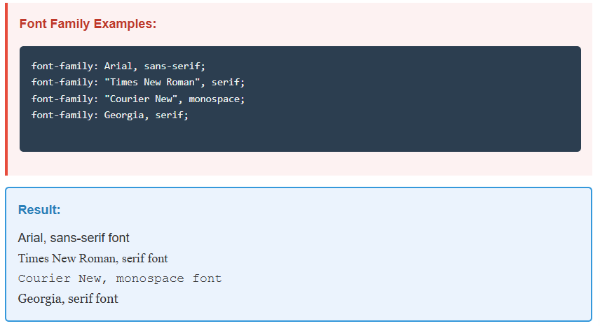
CSS Text and Fonts
  Font Properties

Slide 23
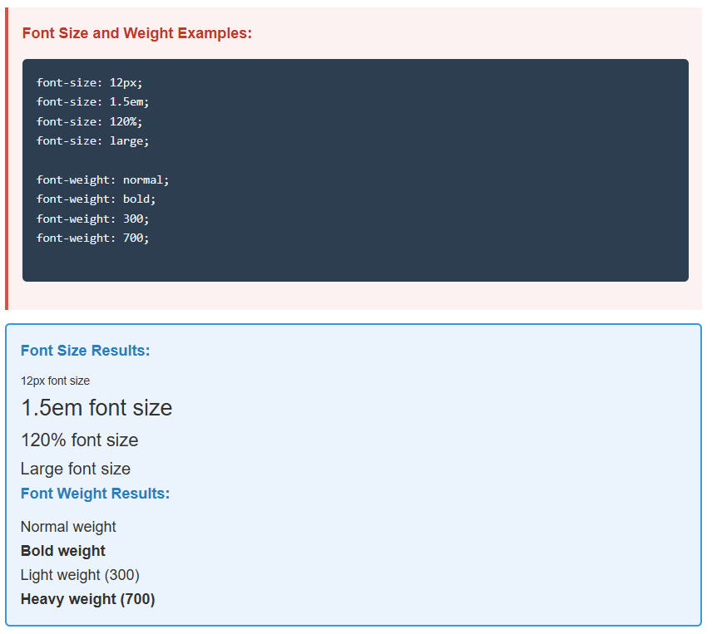
CSS Text and Fonts
  Font Size and Weight

Slide 24
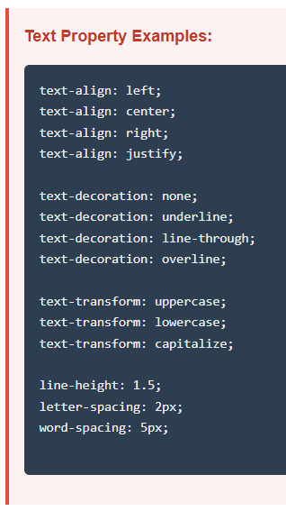
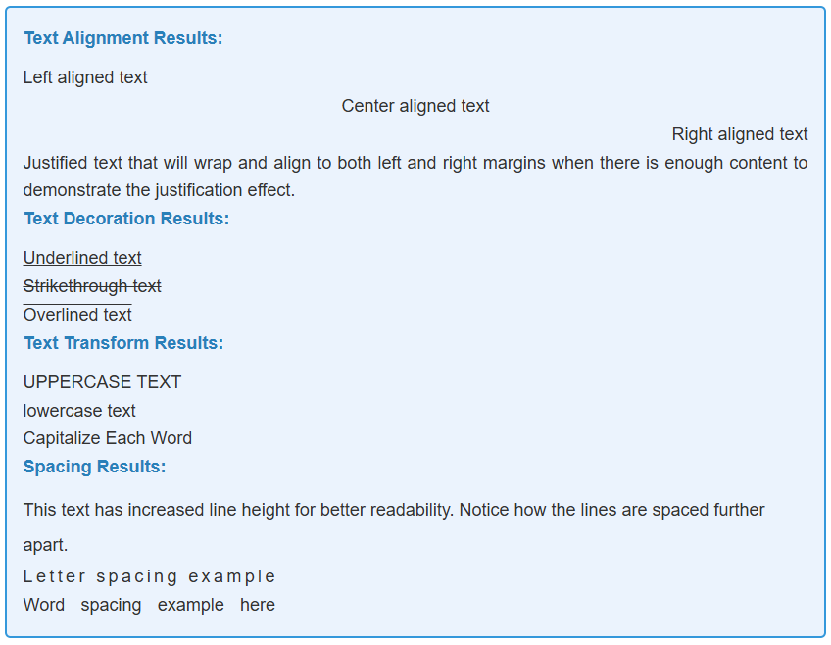
CSS Text and Fonts
  Text Property and Alignment

Slide 25
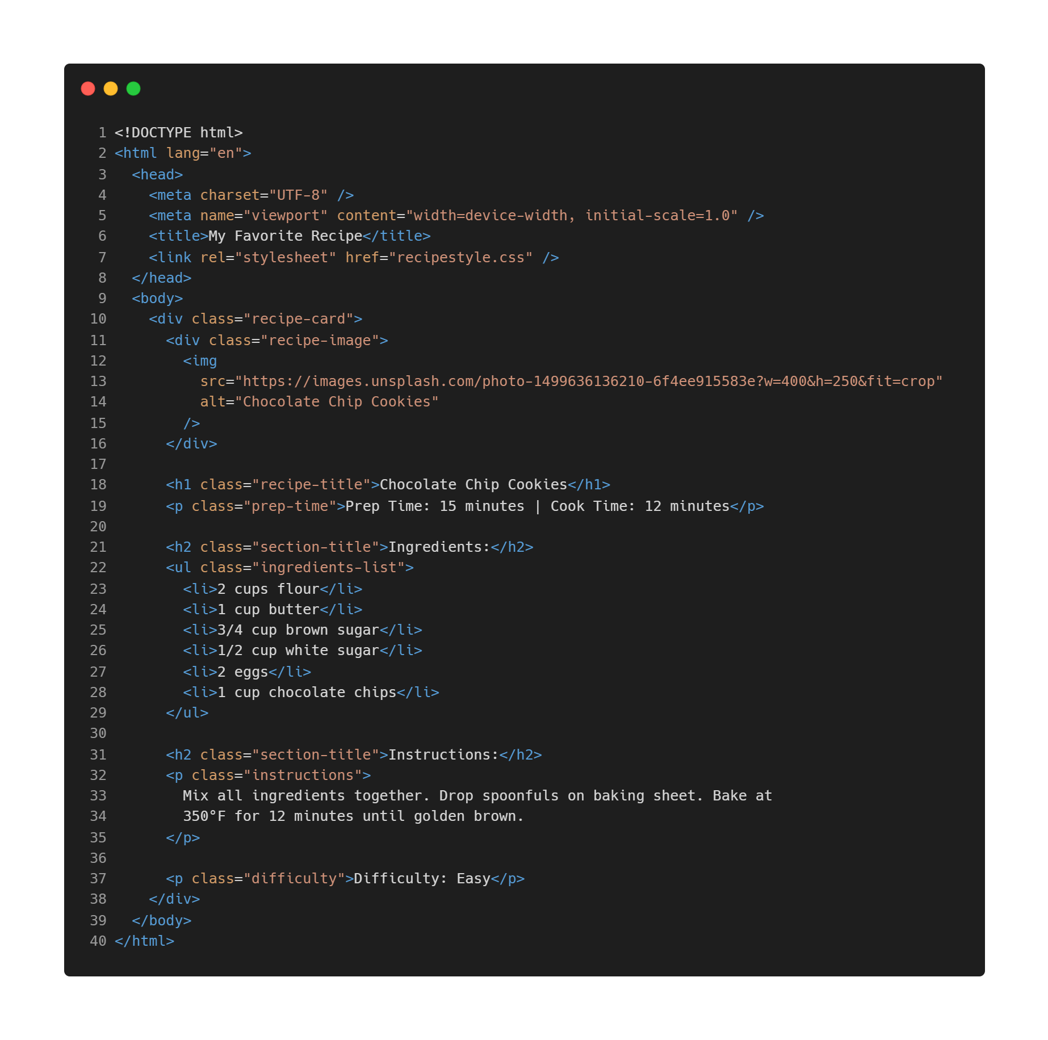
CSS Hands On – Recipe Card
  Create a new “recipecard.html” file and use external .css import file method to link with this HTML file
  You may use any food recipes you like to create this recipe card.
  Take a look at the output of this HTML file without .css file and with .css file import.

Slide 26
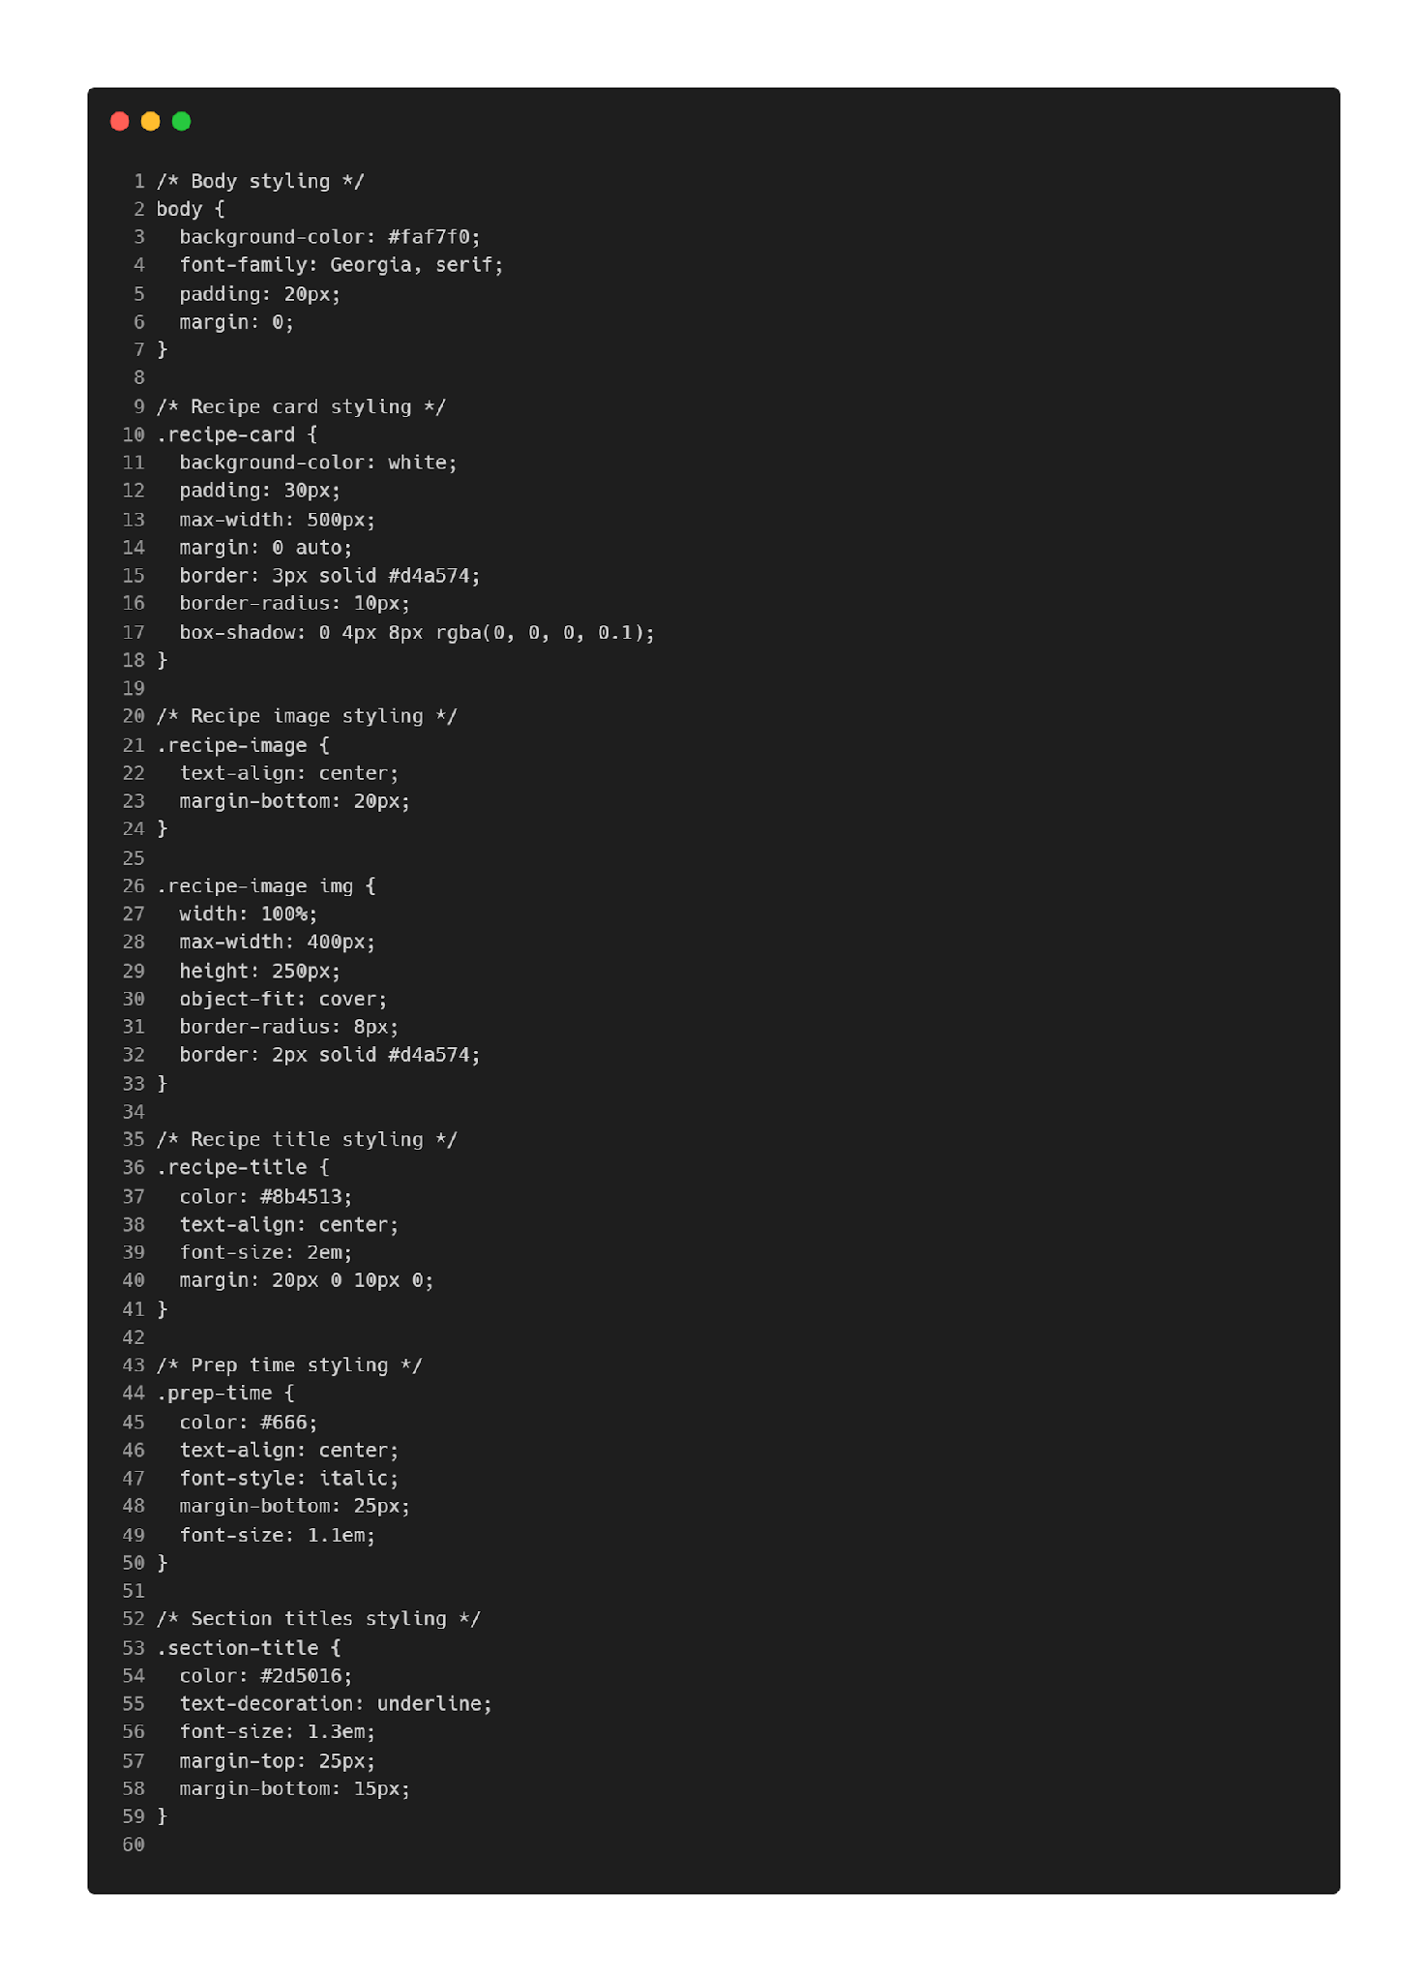
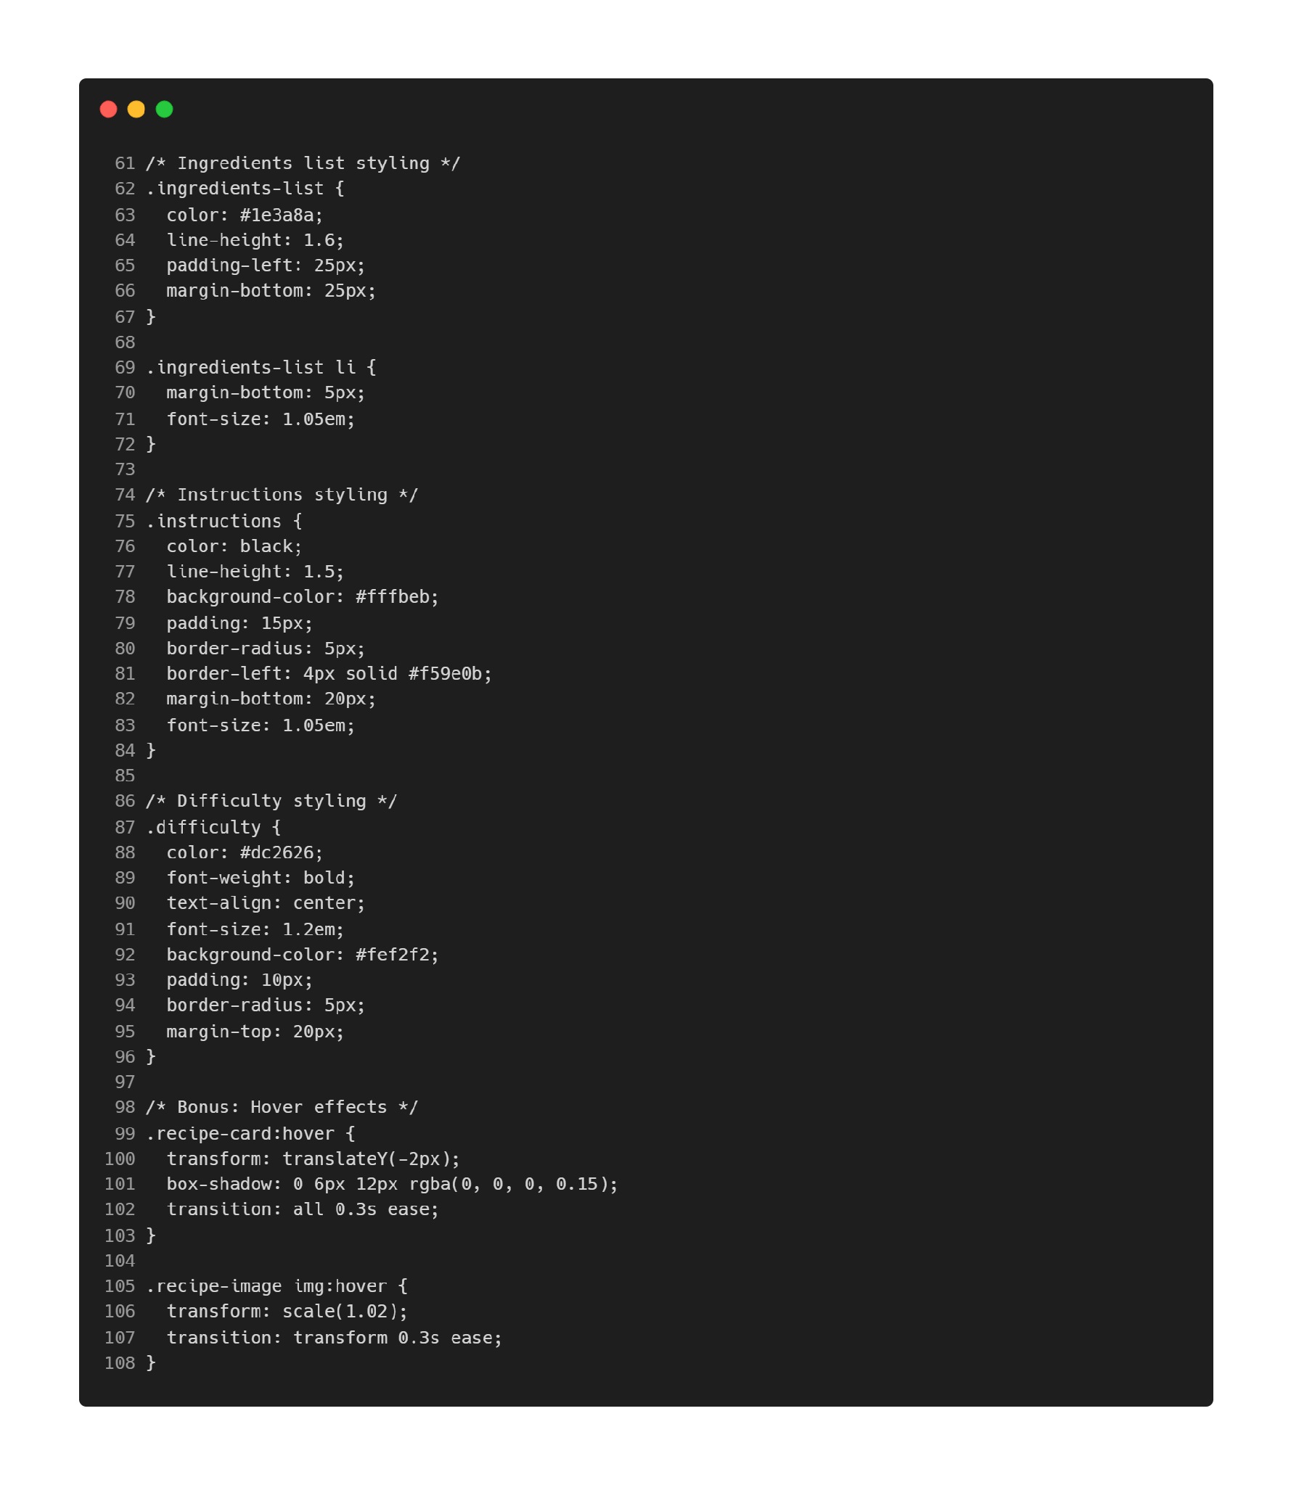
CSS Hands On – Recipe Card
  Create a new “recipestyle.css” file to import and link to recipecard.html file created earlier.
  Try to identify what type of CSS are being used to style the recipe card.

Slide 27
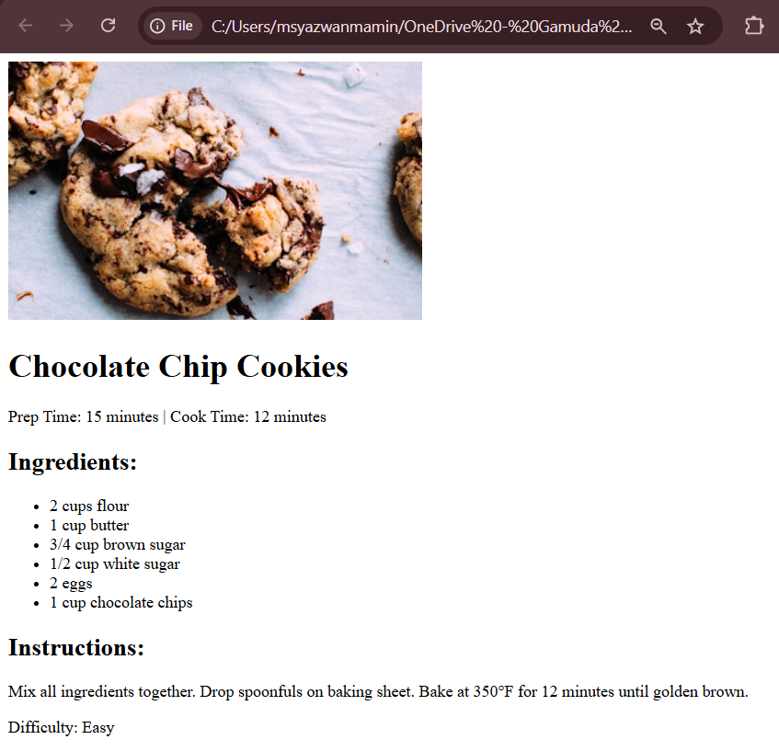
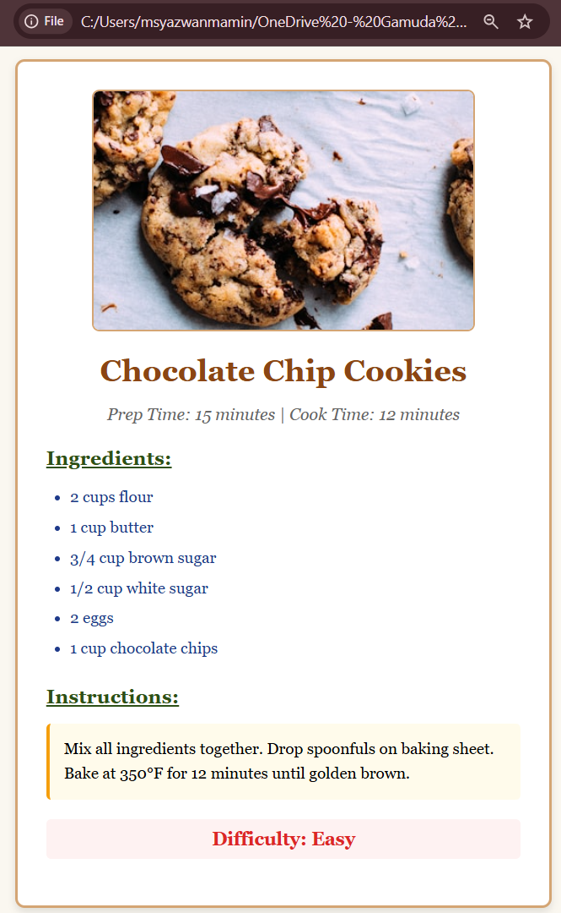
CSS Hands On – Recipe Card
  Output : HTML file without CSS
  Output : HTML file with CSS

